Slide 1
Assignment-1a POS Tagging Using HMM
Group Id-
Himanshu(22b2131)
Parth(22B2261)
Shrikant (22B2244)
Saurabh(22B3905

Slide 2
Problem statement
Objective: Given a sequence of words, produce the POS tag sequence using HMM-Viterbi
Input: The quick brown fox jumps over the lazy dog
Output: The(DET) quick(ADJ) brown(ADJ) fox (NOUN) jumps(VERB) over(ADP) the(DET) lazy(ADJ) dog(NOUN)
Dataset: Brown corpus
• Use Universal Tag Set (12 in number)–
• k-fold cross validation (k=5)

Slide 3
Data pre-processing
To produce accurate POS tags for our brown corpus dataset, we performed the following fundamental pre-processing steps on our data to ensure best model performance:
LOWERCASING: We converted all the words present in our training dataset into lowercase to maintain uniformity in the model data.
TOKENIZATION: We split our dataset into unique words/tokens and incorporated start tokens as (^), while using (.) as our end tokens.

Slide 4
Overall performance
Precision = 0.945
Recall = 0.944
F- scores:
F1-score = 0.951
F0.5-score =0.945
F2-score = 0.945

Slide 5
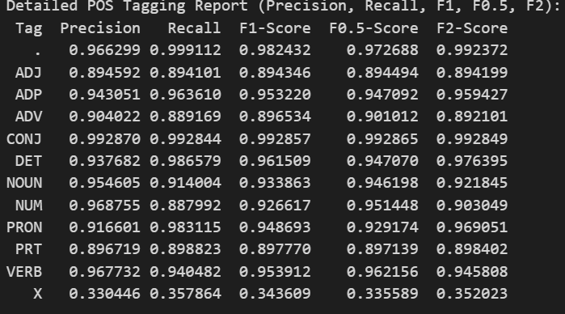
Per pos performance

Slide 6
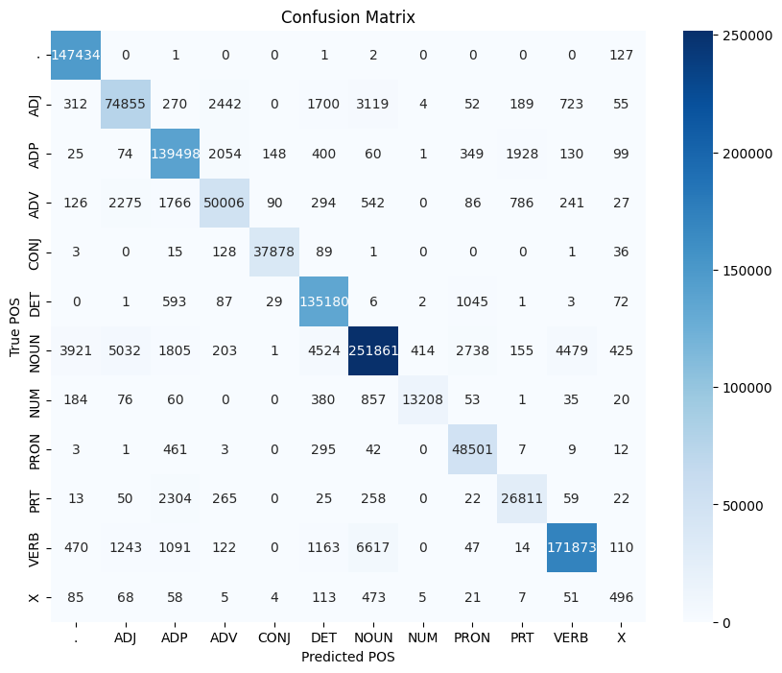
Confusion matrix

Slide 7
Interpretation of confusion matrix
The highest correct classification is for the "NOUN" category, with 251,861 instances accurately predicted.
The "ADP" category also shows a high number of correct predictions (139,498), with minimal confusion with other classes.
Misclassification is evident between the "NOUN" and "ADJ" categories, with 5,032 "NOUN" instances incorrectly predicted as "ADJ."
The "PRON" category has relatively low confusion, with most predictions being correct (48,501), although some misclassifications are observed.
The NOUN category shows highest correct classification, due to their abundance in sentences, as well as distinct linguistic features like morphological characteristics and syntactic roles.
The ADP category also shows accurate predictions because adpositions usually function to connect nouns/pronouns with other elements and have less interpretations and are abundant.
The reason for the high confusion between the NOUN and ADJ categories is that nouns and adjective can have overlapping meanings, making it challenging for the model to distinguish between them. For example, "red" can be a noun (e.g., "the color red") or an adjective (e.g., "a red apple").
Pronouns have unique characteristics (e.g., personal, possessive, demonstrative) that can make them relatively easy to identify. They generally have fewer potential interpretations compared to nouns, adjectives, or verbs and hence show less confusion.

Slide 8
Viterbi algorithm
For the Viterbi algorithm in the code, I implemented it manually without using any external library or API. The algorithm works as follows:
Initialization: For the first word in the sentence, we calculate the initial probability for each possible POS tag by multiplying the initial tag probability with the emission probability of the word given the tag.
Recursion: For each subsequent word, we compute the maximum probability for each tag by considering all possible previous tags. We multiply the previous tag's probability with the transition probability (from the previous tag to the current tag) and the emission probability (the likelihood of the word given the current tag). The best path for each tag is updated accordingly.
Termination: At the final word, we choose the tag sequence that has the highest overall probability, which gives us the most likely POS tag sequence for the sentence.

Slide 9
BENCHMARKING AGAINST CHATGPT
We conducted a comparison between ChatGPT’s POS tagging predictions and the actual tags using a set of example sentences. After analyzing the results, we obtained the following evaluation metrics:
• Precision: 0.9814
• Recall: 0.9787
• F1-Score: 0.9783
These values indicate that ChatGPT performed quite well, with high precision, recall, and F1-scores, reflecting a strong ability to correctly identify POS tags across various sentence structures.

Slide 10
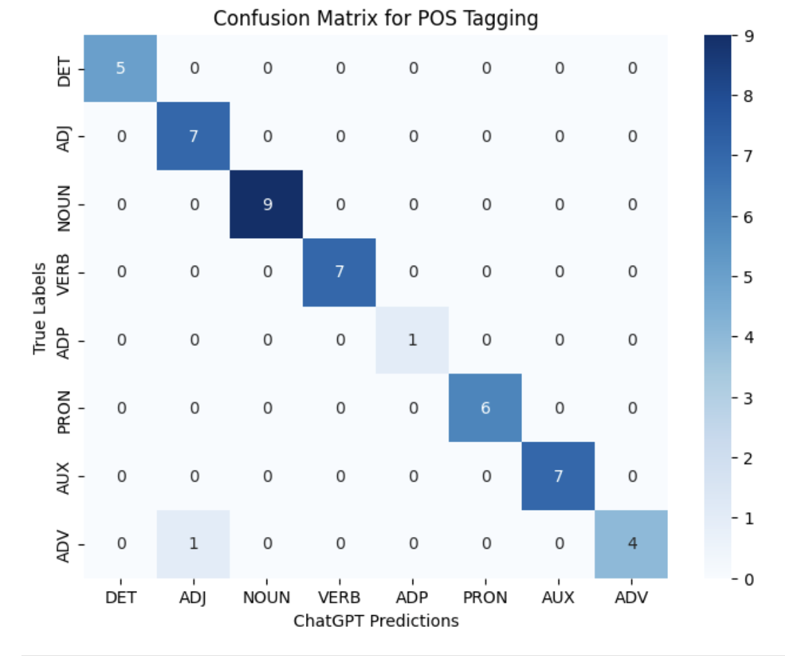
Confusion MATRIX for chatgpt

Slide 11
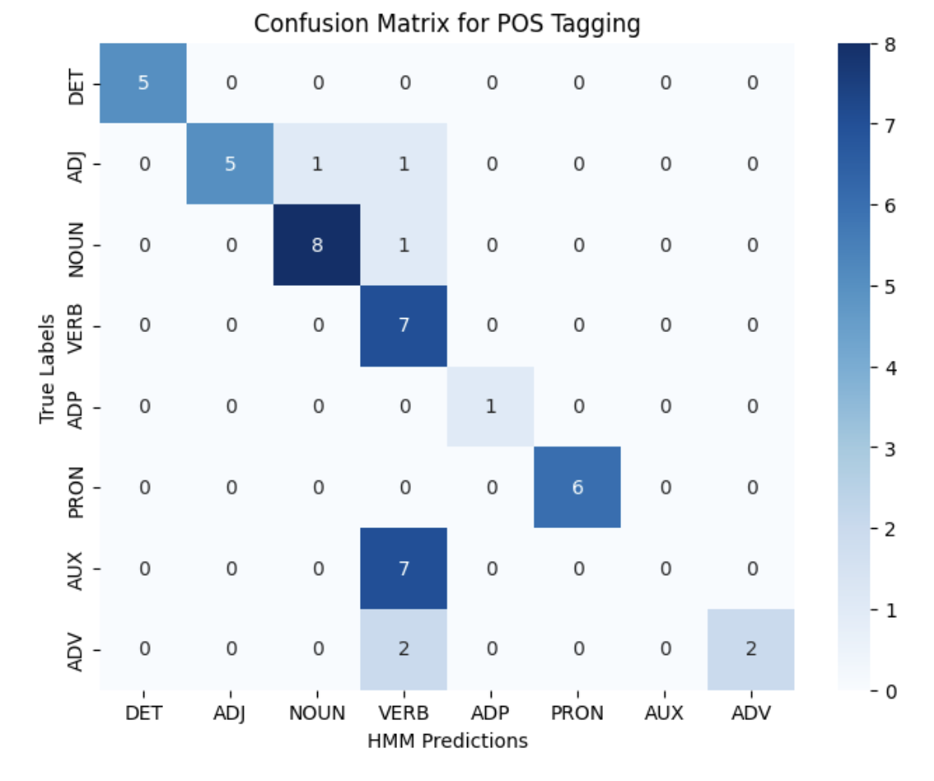
Confusion MATRIX for HMM

Slide 12
Given the small sample size, the confusion matrix may not reflect the full range of potential errors. For a more comprehensive evaluation, expanding the dataset with more diverse and complex sentences would give a clearer picture of ChatGPT’s strengths and weaknesses in POS tagging.

Slide 13
learning
In this assignment, we delved into the implementation and application of the Viterbi algorithm for Part-of-Speech (POS) tagging, a fundamental task in Natural Language Processing (NLP).
We used different transitional and emission probabilities which were obtained using the brown corpus dataset and utilized Viterbi algorithm to predict the POS tags for any given sentence.
We also learnt how to handle problems like handling of start and end of sentence, using different data structures to represent the transitional and lexical tables, using DP instead of recursive algorithms for Viterbi etc.
Using HMM ( hidden markov model), a simple logic for predicting unknown states based on known data, we automated the tagging of different words in a sentence, which can now be used for various purposes like sentiment analysis, query contexting, generating syntactic relationships etc.
We also learnt tools and methodologies which are crucial for any machine learning or mathematical model: eg. UI-UX integration using Gradio, benchmarking against industry standards (LLMs like Chat-GPT in this case) etc.

Slide 14
CHALLENGES FACED
The undertanding of viterbi algorithm and how it uses transitional and emission probabilities to accurately predict best path of tags for a given sentence. It involves backtracking and mapping for each tag, which took some time to understand.
The handling of the starting and ending of sentences also took some time to develop. Although the starting part has been successfully handled using separate variables ‘first_viterbi’ and ‘first_backpointers’, the end of the sentence is yet to be handled, as the input sentence is required to end in ‘ .’ for the model to tag the last word else it tags the last word as punctuation only, which makes sense as in brown corpus, we assume all sentences end in punctuation only.
The handling of unknown variables has been done in our code using the ‘additive smoothing’ method, wherein a small probability is assigned to each word in the input sentence, regardless of it being present in the training corpus (0.001 in our script).
However, there are more nuanced methodology which can be implemented, such as the turing-good smoothing, which calculates the value to be assigned to a unseen word based on more complex paramters, like how many words have appeared a single time with the previous tag as the one observed, etc.

Slide 15
referenceS
For Brown corpus: NLTK Data from nltk.org
For GUI: Gradio
Lecture notes
Online blogs and videos

Slide 16
THANK YOU

